Slide 1
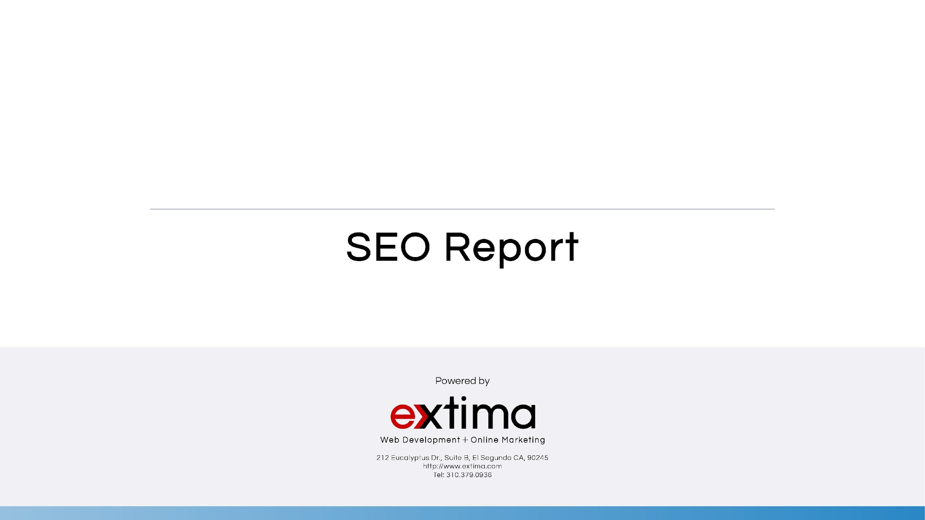

June/July 2019

Slide 2
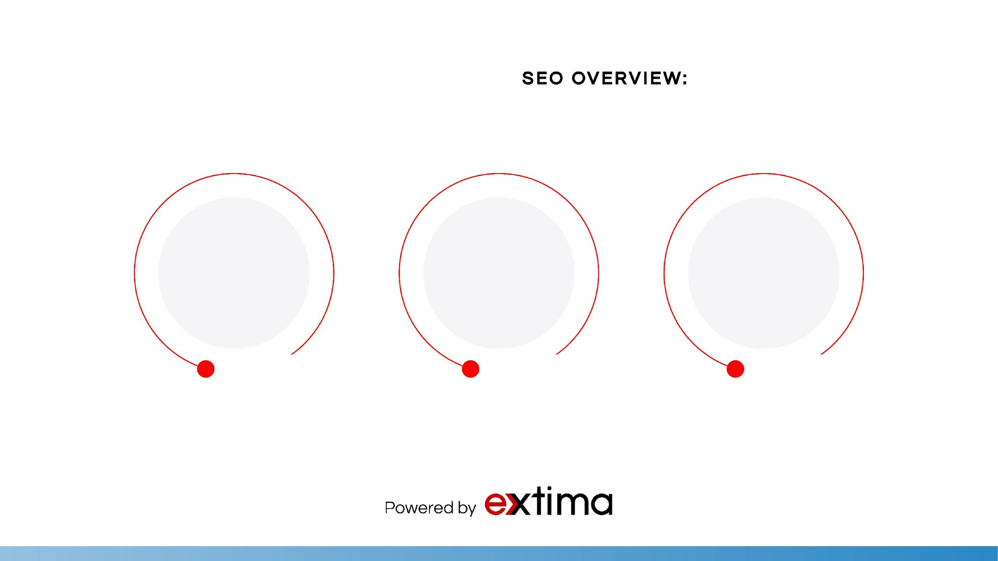
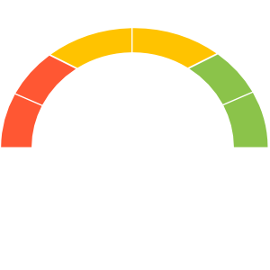
307
GOOD
546
262
Number of sessions to your webpage
Number of pageviews to your website
Number of users to your website

Slide 3
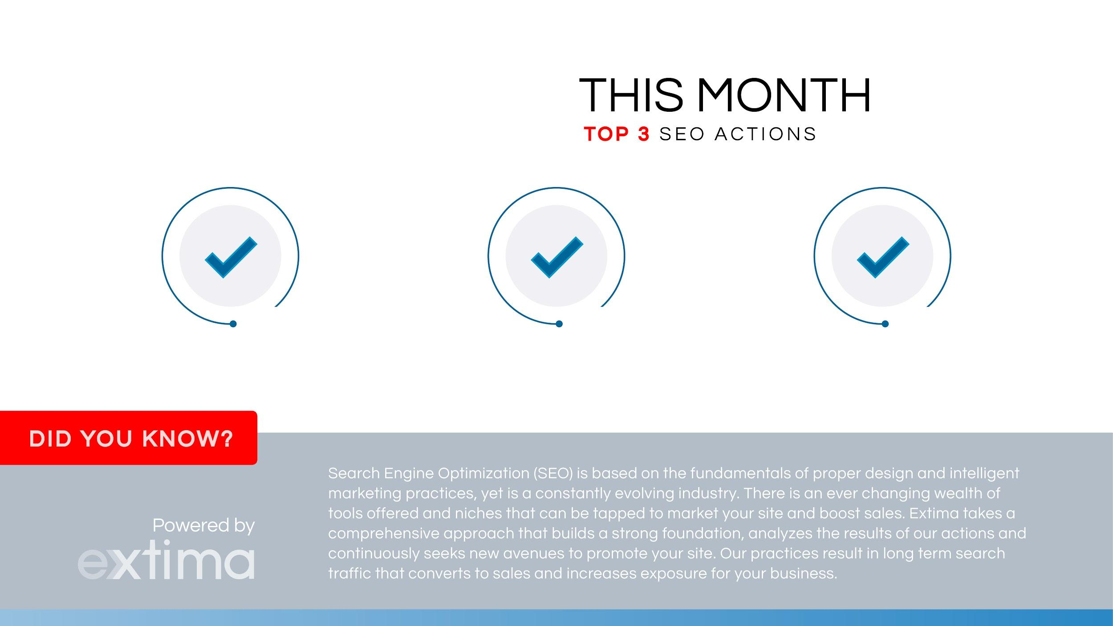
Optimized blog posts and pages to increase keyword rankings.
Re-submit URL links of optimized pages to Google
Checked for broken links in Google Search Console

Slide 4

Your SEO was good this month! Organic search traffic brought in +166 users. Social search traffic brought in +30 users.
We focused on optimizing a blog posts. We shared blog posts on social bookmarking sites to help increase overall sessions across different social media networks. We also checked page speed and keyword rankings for core pages.

Slide 5

Next month, we will optimize and share blog pages with more organic keywords. We will continue sharing the new blog posts from your website onto different social networks to boost exposure and overall high-quality site traffic. We will strive to gain as many organic keywords related to “education” or “mentoring” type searches. We will also work towards implementing core pages into the social campaign.
As always, we will continue monitoring site activity and the Google Search console for website errors.

Slide 6
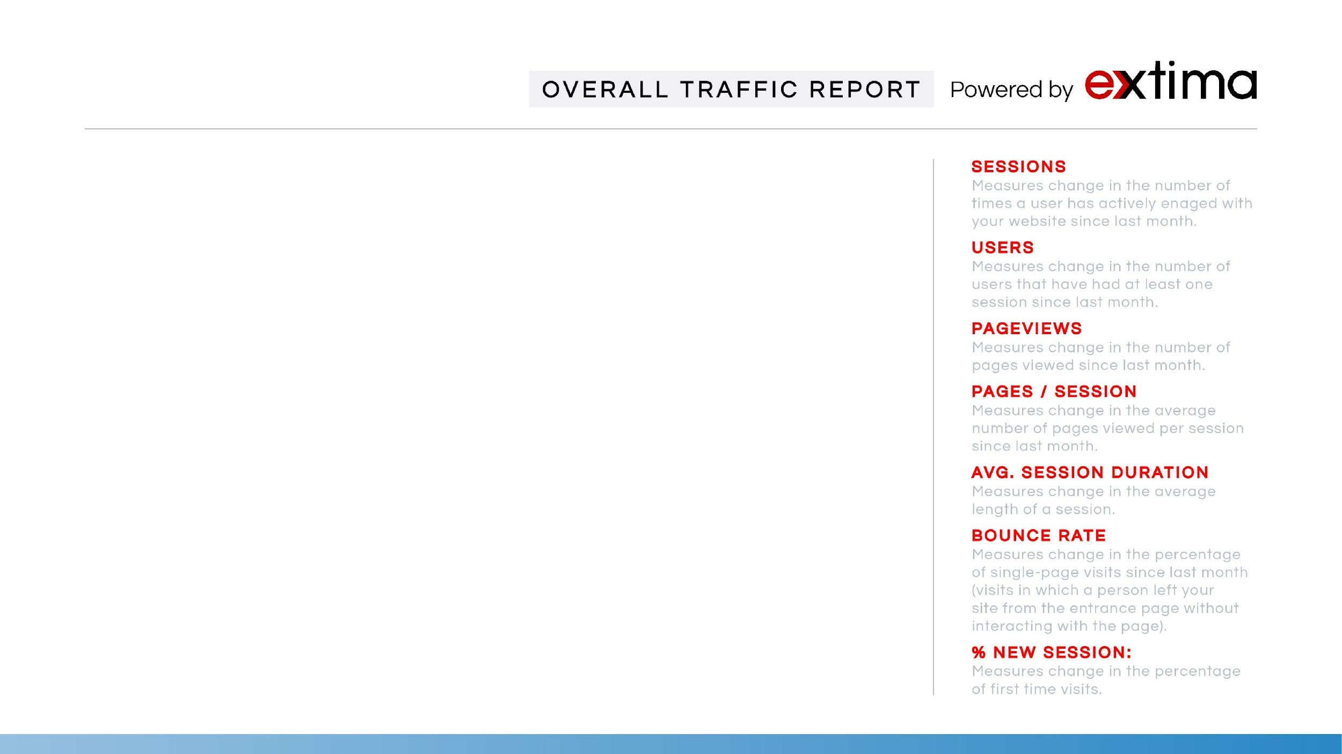
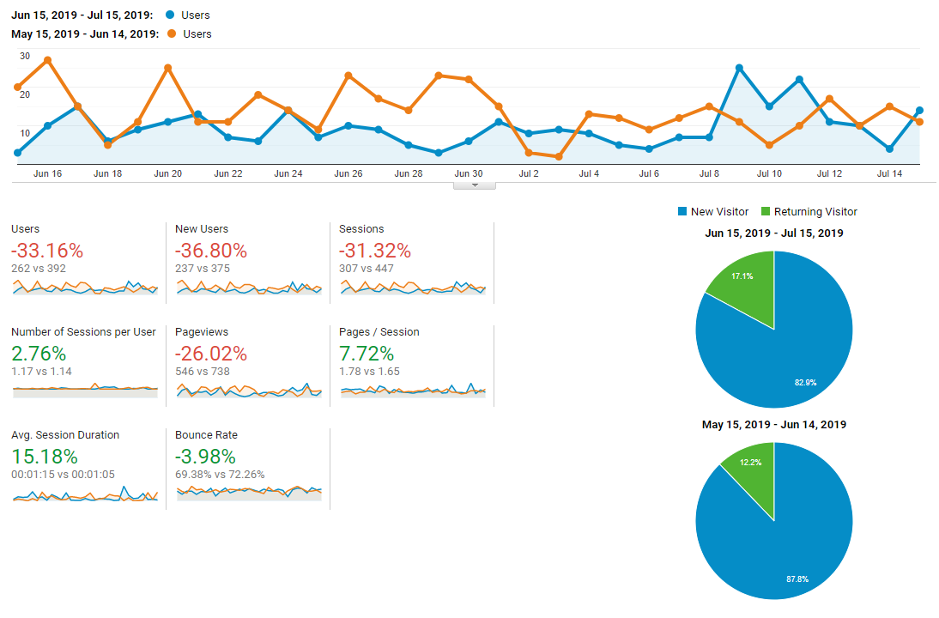

Slide 7
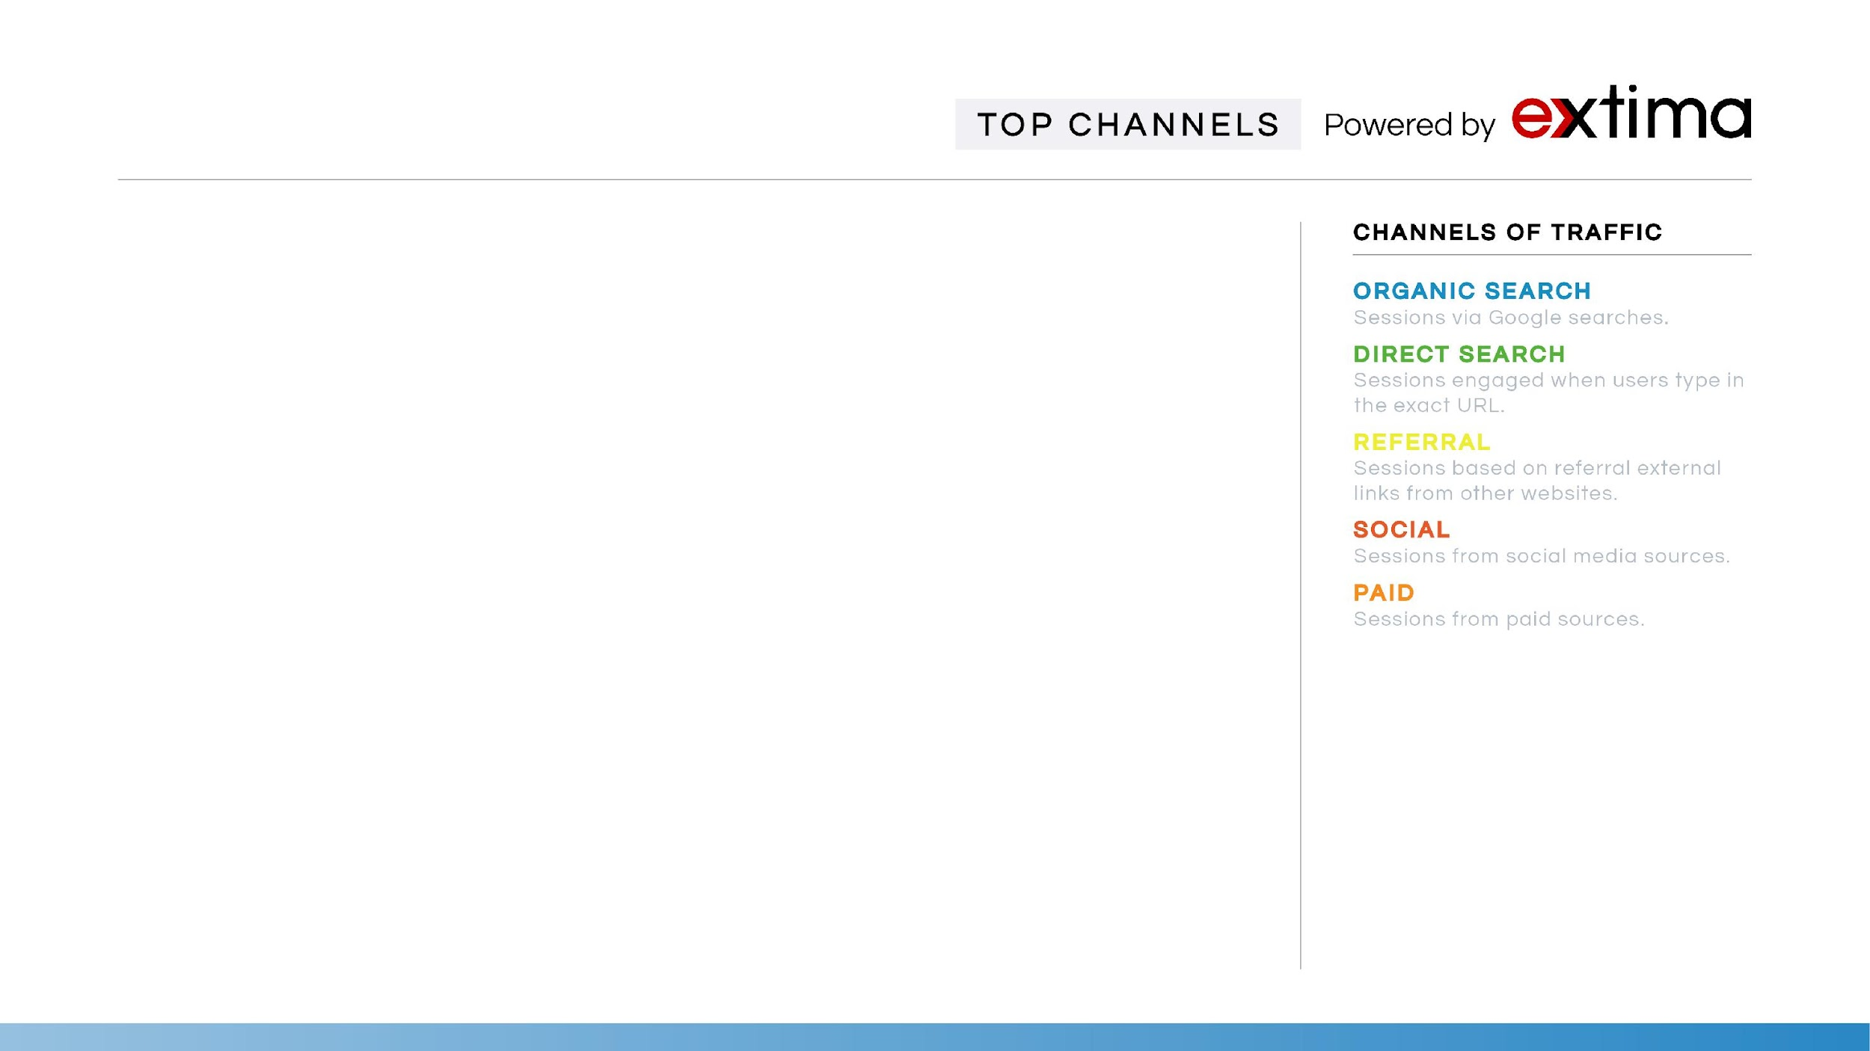
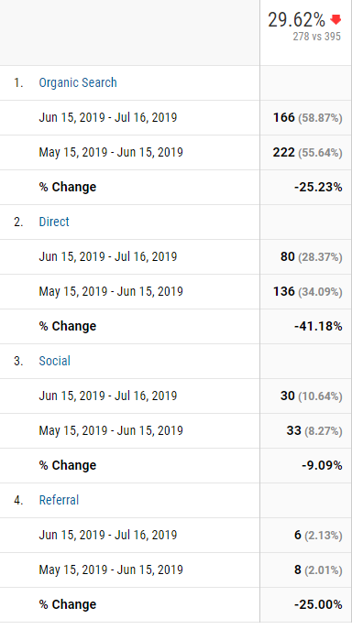
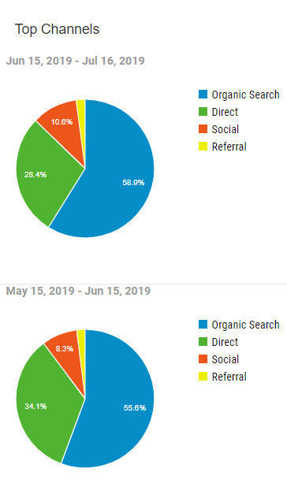

Slide 8
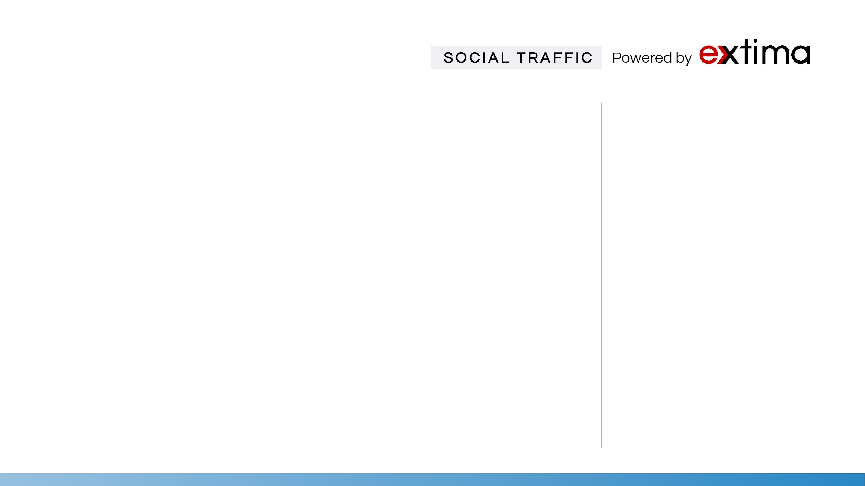
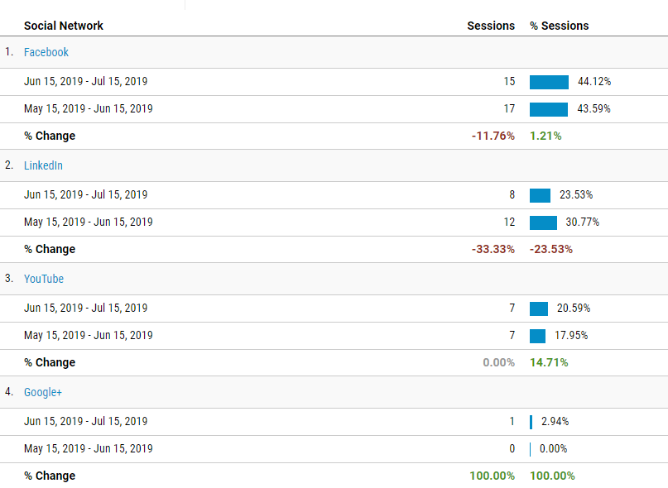
Facebook
Facebook is a social networking site that makes it easy for you to connect and share with your family and friends online.
Twitter
Twitter is an online news and social networking service where users post and interact with "tweets".
Instagram
Instagram is a social networking app made for sharing photos and videos from a smartphone.
Reddit
Reddit is an American social news aggregation, web content rating, and discussion website.
StumbleUpon
StumbleUpon is a discovery engine that finds and recommends web content to its users.

Slide 9
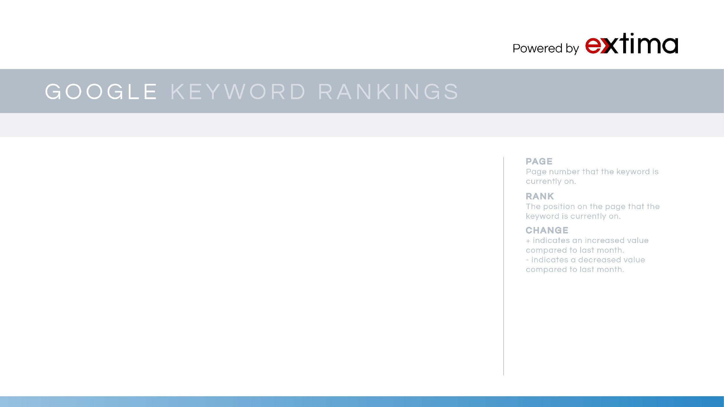
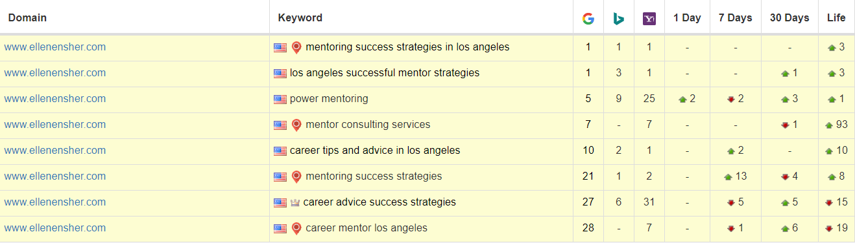
GOOGLE & BING KEYWORD RANKINGS

Slide 10
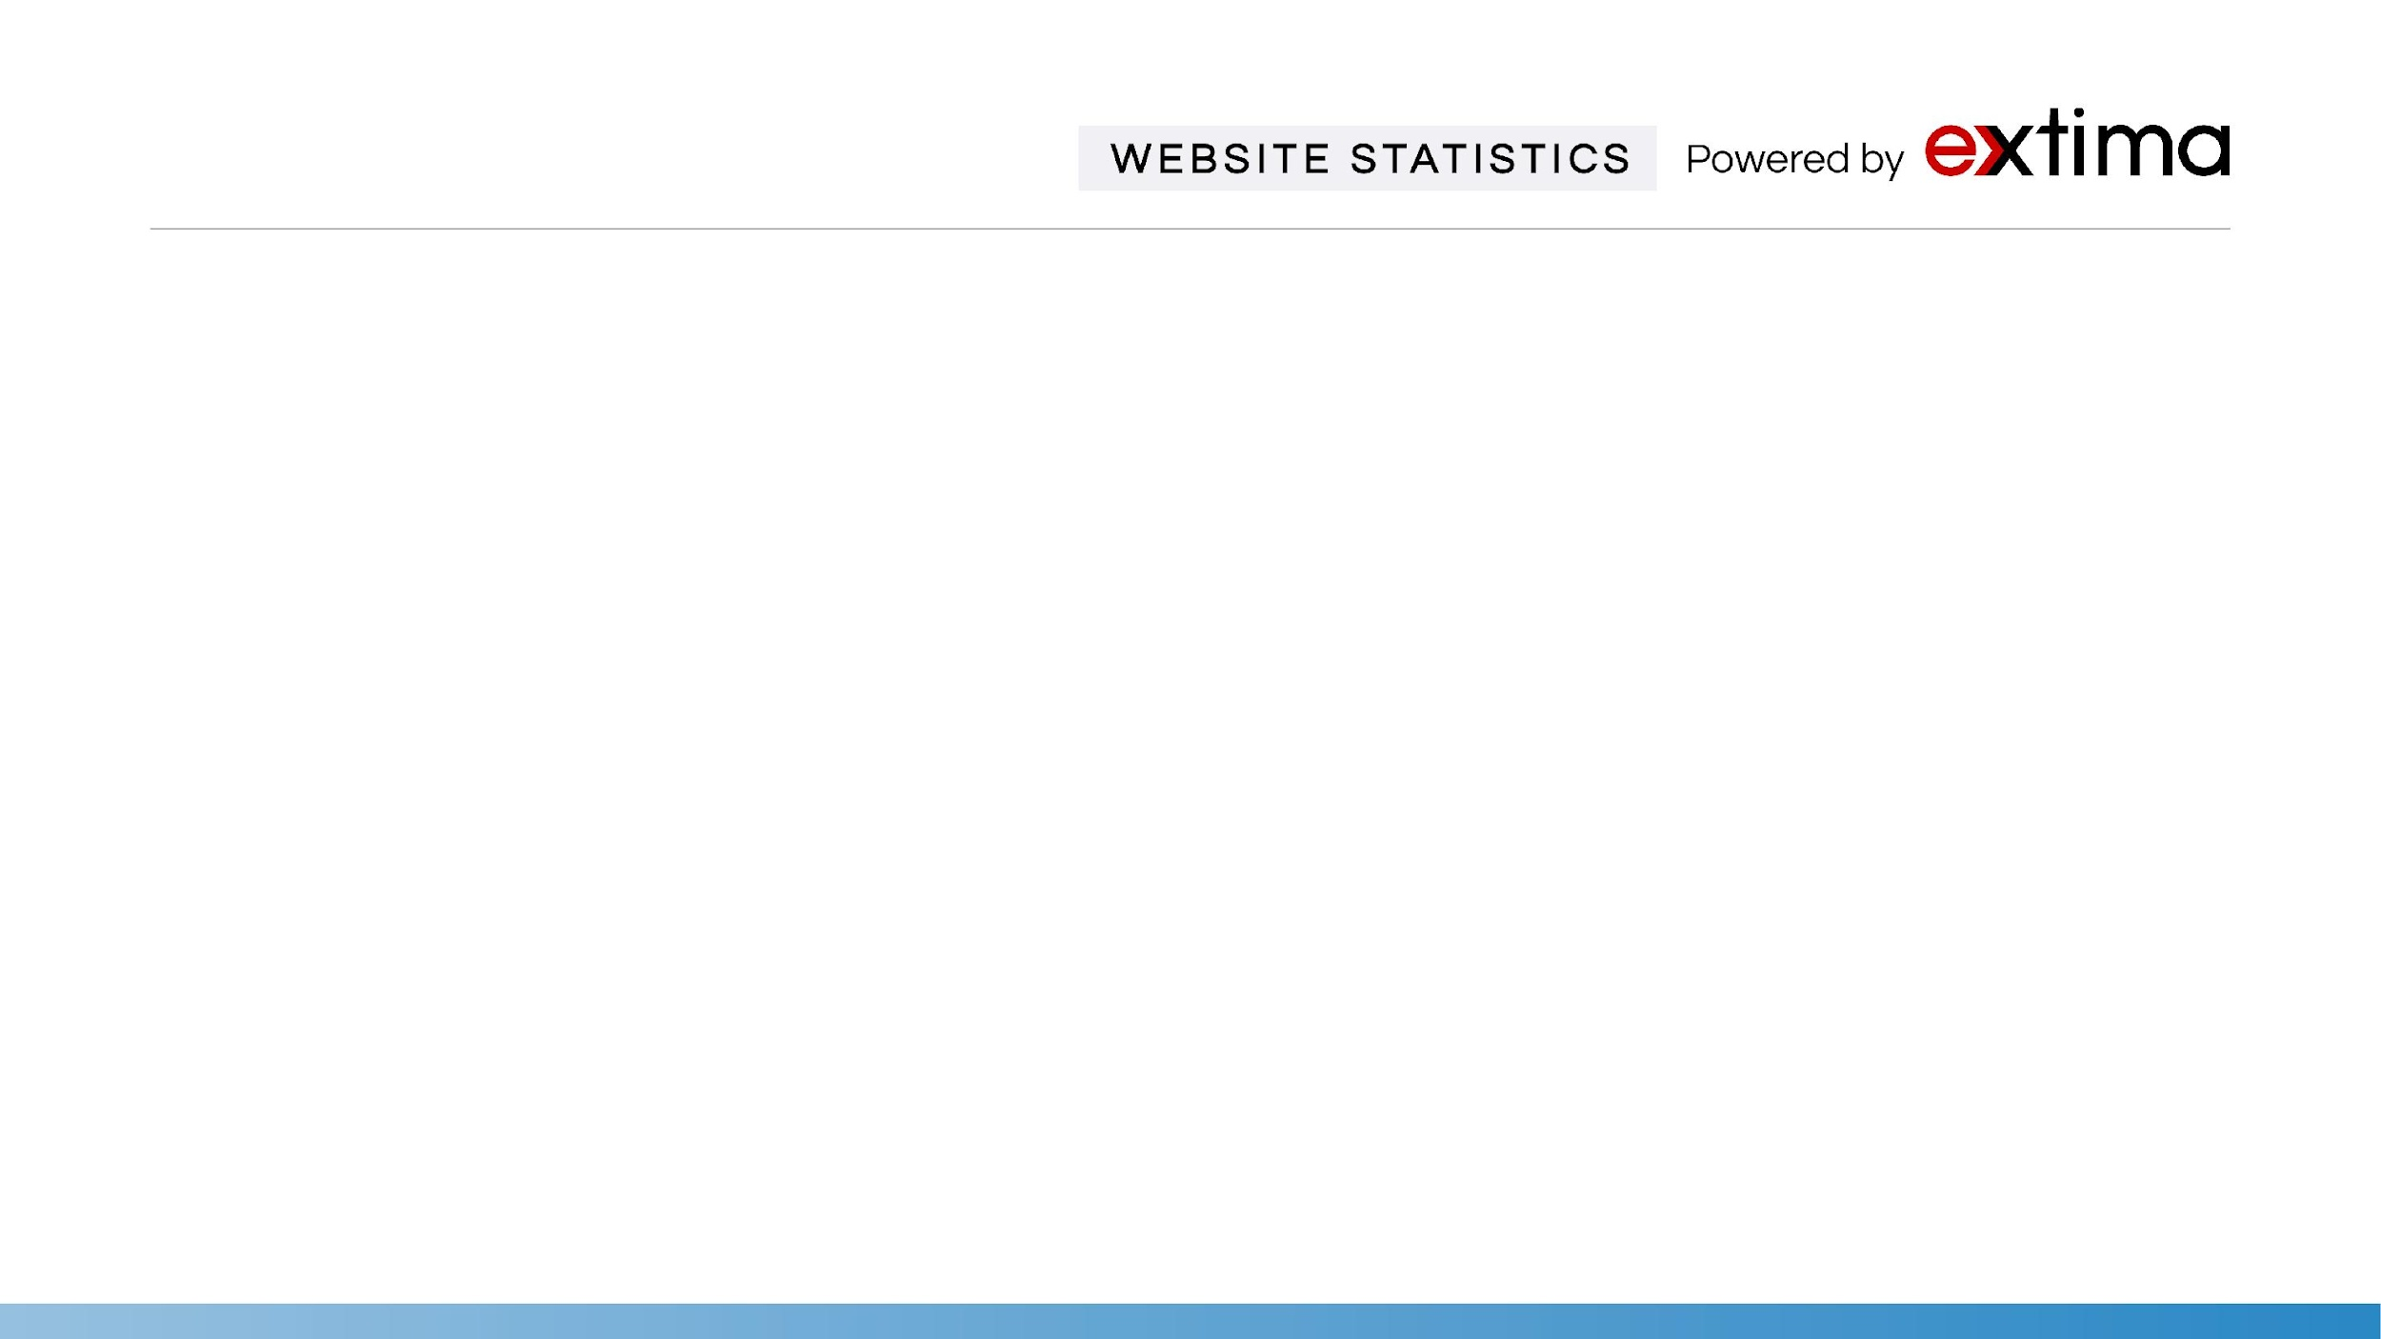
Statistics | May | Jun | July | Comments
Google Index | 423 | 395 | 473 | Google Index is the number of links currently indexed in Google’s database.
Marketing Grade | 71% | 71% | 69% | Market Grader uses a blend of different variables, including site performance, Mobile design, SEO, and Security.
Ranking Keywords | 86 | 72 | 71 | Home Page Rank shows how strong a backlink profile is relative to your home page.
Domain Rank | 30/100 | 30/100 | 30/100 | Domain Rank shows how strong a backlink profile is relative to your whole site.
Linking Root Domains | 157 | 140 | 155 | Total number of websites linking back to your website.
Total Links | 2.2K | 1.7K | 2.2K | Total number of links driving traffic to your site. We will continue a campaign to aggressively acquire more links.
Alexa Rank | 4.92M | 11.2M | 5.66M | Alexa measures relative traffic levels. A low rank suggests high traffic levels and an important website. * = Rank still hasn’t refreshed on their database.

Slide 11


